Slide 1
Archana A
Bachelor of Engineering
Computer science and engineering
211521104011
3/21/2024 Annual Review

Slide 2
PROJECT TITLE
Generation Of Anime Characters Using GAN
3/21/2024 Annual Review

Slide 3


AGENDA
1.Problem Statement
2.Project Overview
3.Who are the end users?
4.Your solutions and its Propositions
5.The wow in your solutions
6.Modeling
7.Results
3/21/2024 Annual Review

Slide 4

PROBLEM STATEMENT
Develop a Generative Adversarial Network (GAN) model capable of generating diverse and high-quality anime character images. Train the GAN on a dataset of anime character images to learn the intricate features and styles unique to anime characters. Address challenges such as maintaining diversity, preserving artistic integrity, and avoiding mode collapse to produce realistic and novel character designs.
3/21/2024 Annual Review

Slide 5

PROJECT OVERVIEW
This project analyses dataset aims to classify species into different types using logistic regression.
Data Prep:
Collect and preprocess anime character images.
Model Selection:
Choose GAN architecture (e.g., DCGAN, StyleGAN).
Training:
Train GAN on dataset, adjusting hyperparameters.
Evaluation:
Assess image quality and diversity using metrics and human judgment.
Challenges:
Address training issues like mode collapse and instability.
Applications:
Explore uses in animation, gaming, and character design.
3/21/2024 Annual Review

Slide 6

WHO ARE THE END USERS?
Data Collection and Preprocessing:
Gather anime character images from diverse sources.
Preprocess images to standardize format and quality.
Model Training and Optimization:
Train GAN architecture on preprocessed dataset.
Optimize training process for stable convergence and high-quality outputs.
Evaluation and Validation:
Assess generated images for realism and diversity.
Validate model performance using quantitative metrics and human judgment.
Challenges and Solutions:
Address issues like mode collapse and training instability.
Implement techniques for stable and efficient training.
Applications and Future Directions:
Explore usage in animation, gaming, and character design industries.
Consider advancements in generative modeling for broader applications.
3/21/2024 Annual Review

Slide 7

YOUR SOLUTION AND ITS VALUE PROPOSITION
High-Quality Outputs:
By utilizing advanced GAN architectures like DCGAN or StyleGAN, we ensure the generation of high-quality and visually appealing anime character images.
Diverse Designs:
Our model is designed to produce diverse anime character designs, offering a wide range of options suitable for various applications in animation, gaming, and character design.
Efficient Training:
We employ effective training techniques and address common challenges in GAN training, such as mode collapse and instability, ensuring efficient convergence and optimal performance.
Evaluation and Improvement:
We thoroughly evaluate the generated images using both quantitative metrics and qualitative human judgment, allowing for continuous improvement and refinement of the model.
Practical Applications:
Our solution opens up opportunities for practical applications in industries such as animation, gaming, and character design, enabling creators to access a diverse set of anime character designs for their projects.
3/21/2024 Annual Review

Slide 8
THE WOW IN YOUR SOLUTION
Unmatched Creativity: Our solution redefines character design with advanced GAN technology, inspiring creators with unprecedented creative freedom and astonishing results.
Infinite Diversity: From whimsical to fierce, our model produces an endless variety of characters, each with its own captivating narrative and style.
Seamless Integration, Limitless Innovation: Integrating seamlessly into workflows, we empower creators to innovate effortlessly, pushing the boundaries of character design and storytelling.
Dreams to Reality: We bridge imagination and manifestation, turning dreams into tangible, awe-inspiring art with every creation.
3/21/2024 Annual Review

Slide 9
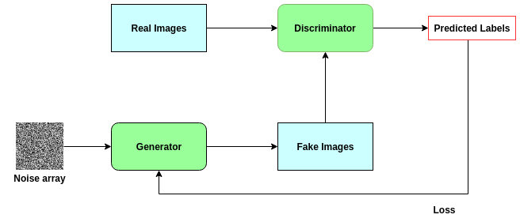
MODELLING

Slide 10
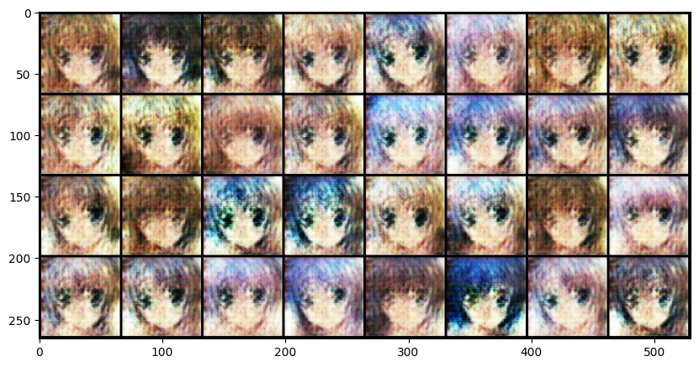
RESULTS
In conclusion, employing Generative Adversarial Networks (GANs) for anime character generation yields promising results, offering efficient creation of diverse and creative designs. Despite challenges such as ensuring diversity and requiring extensive datasets for training, GANs present an exciting opportunity for automating character creation in the anime industry.

